Slide 1
Lecture 12
    Chapter 9
Computer Arithmetic

Slide 2
Computer Arithmetic
  CPU combines of ALU and Control Unit, this chapter discusses ALU
The Arithmetic and Logic Unit (ALU)
Number Systems
Integer Representation
Integer Arithmetic
Floating-Point Representation
Floating-Point Arithmetic
CH08

Slide 3
Arithmetic & Logic Unit
Does the calculations
Everything else in the computer is there to service this unit
Handles integers
May handle floating point (real) numbers
May be separate FPU (maths co-processor)
May be on chip separate FPU (486DX +)

Slide 4
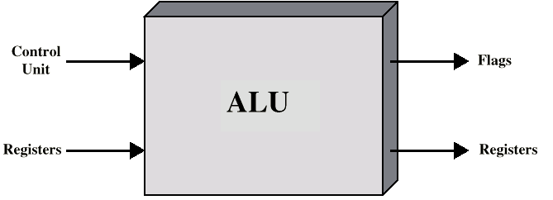
ALU Inputs and Outputs

Slide 5
Number Systems
  ALU does calculations with binary numbers
Decimal number system
  Uses 10 digits (0,1,2,3,4,5,6,7,8,9)
  In decimal system, a number 84, e.g., means
  84 = (8x10) + 3
  4728 = (4x1000)+(7x100)+(2x10)+8
  Base or radix of 10: each digit in the number is multiplied by 10 raised to a power corresponding to that digit’s position
  E.g. 83 = (8x10¹)+ (3x10⁰)
  4728 = (4x10³)+(7x10²)+(2x10¹)+(8x10⁰)

Slide 6
Decimal number system…
Fractional values, e.g.
  472.83=(4x10²)+(7x10¹)+(2x10⁰)+(8x10⁻¹)+(3x10⁻²)
  In general, for the decimal representation of
  X = {… x₂x₁x_{0.}x₋₁x₋₂x₋₃ … }
  X = ∑ _{i} x_{i}10^{i}

Slide 7
Binary Number System
Uses only two digits, 0 and 1
It is base or radix of 2
Each digit has a value depending on its position:
  10₂ = (1x2¹)+(0x2⁰) = 2₁₀
  11₂ = (1x2¹)+(1x2⁰) = 3₁₀
  100₂ = (1x2²)+ (0x2¹)+(0x2⁰) = 4₁₀
  1001.101₂ = (1x2³)+(0x2²)+ (0x2¹)+(1x2⁰)
  +(1x2⁻¹)+(0x2⁻²)+(1x2⁻³) = 9.625₁₀

Slide 8
Decimal to Binary conversion
Integer and fractional parts are handled separately,
  Integer part is handled by repeating division by 2
  Factional part is handled by repeating multiplication by 2
E.g. convert decimal 11.81 to binary
  Integer part 11
  Factional part .81

Slide 9
Decimal to Binary conversion, e.g. //
e.g. 11.81 to 1011.11001 (approx)
  11/2 = 5 remainder 1
  5/2 = 2 remainder 1
  2/2 = 1 remainder 0
  1/2 = 0 remainder 1
  Binary number 1011
  .81x2 = 1.62 integral part 1
  .62x2 = 1.24 integral part 1
  .24x2 = 0.48 integral part 0
  .48x2 = 0.96 integral part 0
  .96x2 = 1.92 integral part 1
  Binary number .11001 (approximate)

Slide 10
Hexadecimal Notation:
  command ground between computer and Human
Use 16 digits, (0,1,3,…9,A,B,C,D,E,F)
1A₁₆ = (1₁₆ x 16¹)+(A₁₆ x 16º)
= (1₁₀ x 16¹)+(10₁₀ x 16⁰)=26₁₀
Convert group of four binary digits to/from one hexadecimal digit,
  0000=0; 0001=1; 0010=2; 0011=3; 0100=4; 0101=5; 0110=6; 0111=7; 1000=8; 1001=9; 1010=A; 1011=B; 1100=C; 1101=D; 1110=E; 1111=F;
e.g.
  1101 1110 0001. 1110 1101 = DE1.DE

Slide 11
Integer Representation (storage)
Only have 0 & 1 to represent everything
Positive numbers stored in binary
  e.g. 41=00101001
No minus sign
No period
How to represent negative number
  Sign-Magnitude
  Two’s compliment

Slide 12
Sign-Magnitude
Left most bit is sign bit
0 means positive
1 means negative
+18 = 00010010
-18 = 10010010
Problems
  Need to consider both sign and magnitude in arithmetic
  Two representations of zero (+0 and -0)

Slide 13
Two’s Compliment (representation)
+3 = 00000011
+2 = 00000010
+1 = 00000001
+0 = 00000000
-1 = 11111111
-2 = 11111110
-3 = 11111101

Slide 14
Benefits
One representation of zero
Arithmetic works easily (see later)
Negating is fairly easy (2’s compliment operation)
  3 = 00000011
  Boolean complement gives 11111100
  Add 1 to LSB 11111101

Slide 15
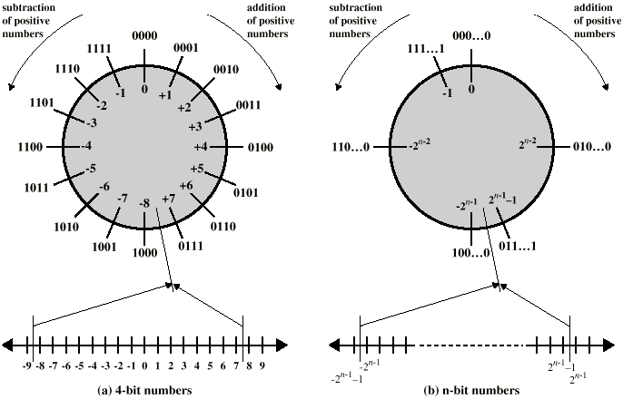
Geometric Depiction of Twos Complement Integers

Slide 16
Range of Numbers
8 bit 2s compliment
  +127 = 01111111 = 2⁷ -1
  -128 = 10000000 = -2⁷
16 bit 2s compliment
  +32767 = 011111111 11111111 = 2¹⁵ - 1
  -32768 = 100000000 00000000 = -2¹⁵

Slide 17
Conversion Between Lengths
Positive number pack with leading zeros
+18 = 00010010
+18 = 00000000 00010010
Negative numbers pack with leading ones
-18 = 10010010
-18 = 11111111 10010010
i.e. pack with MSB (sign bit)

Slide 18
Integer Arithmetic: Negation
  Take Boolean complement of each bit, I.e. each 1 to 0, and each 0 to 1.
  Add 1 to the result
  E.g. +3 = 011
  Bitwise complement = 100
  Add 1
  = 101
  = -3

Slide 19
Negation Special Case 1
0 = 00000000
Bitwise not 11111111
Add 1 to LSB +1
Result 1 00000000
Overflow is ignored, so:
- 0 = 0

Slide 20
Negation Special Case 2
-128 = 10000000
bitwise not 01111111
Add 1 to LSB +1
Result 10000000
So:
-(-128) = -128 NO OK!
Monitor MSB (sign bit)
It should change during negation
>> There is no representation of +128 in this case. (no +2^{n})

Slide 21
Addition and Subtraction
Normal binary addition
0011 0101 1100
+0100 +0100 +1111
-------- ---------- ------------
0111 1001 = overflow 11011
Monitor sign bit for overflow (sign bit change as adding two positive numbers or two negative numbers.)
Subtraction: Take twos compliment of subtrahend then add to minuend
  i.e. a - b = a + (-b)
So we only need addition and complement circuits

Slide 22
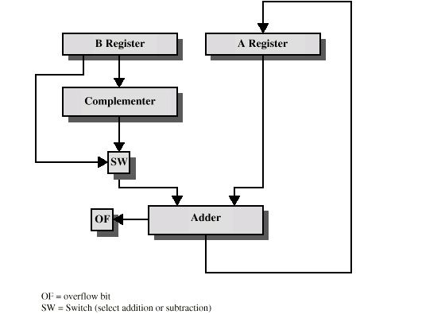
Hardware for Addition and Subtraction

Slide 23
Multiplication
Complex
Work out partial product for each digit
Take care with place value (column)
Add partial products

Slide 24
Multiplication Example
(unsigned numbers e.g.)
1011 Multiplicand (11 dec)
x 1101 Multiplier (13 dec)
1011 Partial products
0000 Note: if multiplier bit is 1 copy
1011 multiplicand (place value)
1011 otherwise zero
10001111 Product (143 dec)
Note: need double length result

Slide 25
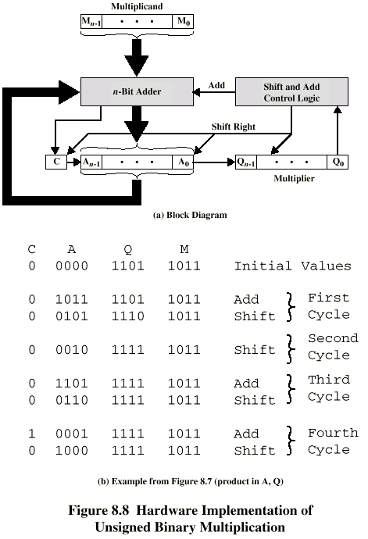
Unsigned Binary Multiplication

Slide 26
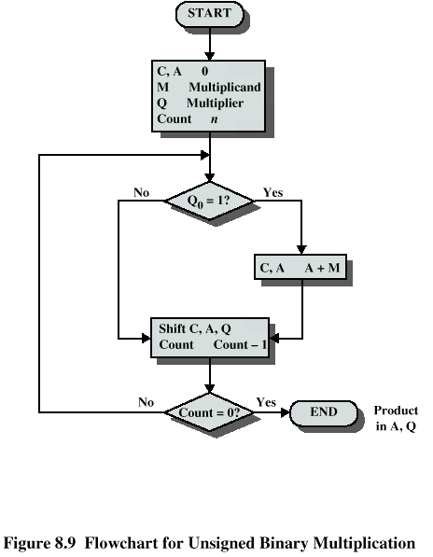
Flowchart for Unsigned Binary Multiplication

Slide 27
Execution of Example

Slide 28
Multiplying Negative Numbers
The previous method does not work!
Solution 1
  Convert to positive if required
  Multiply as above
  If signs of the original two numbers were different, negate answer
Solution 2
  Booth’s algorithm

Slide 29
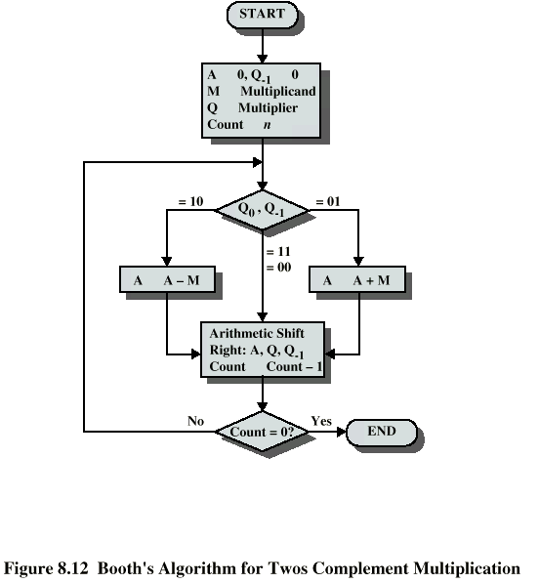
Booth’s Algorithm

Slide 30
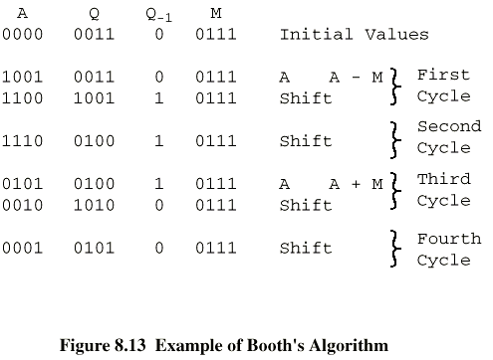
Example of Booth’s Algorithm

Slide 31
Example: Multiplication Using Booth’s Algorithm
0111
* 1101 (0)
11111001 1-0
0000111 0-1
111001 1-0
11101011 (-21)
7*-3=-21
-7*-3=21
1001
* 1101 (0)
00000111 1-0
1111001 0-1
000111 1-0
00010101

Slide 32
Division
More complex than multiplication
However, can utilize most of the same hardware.
Based on long division

Slide 33
Division of Unsigned Binary Integers
00001101
Quotient
Divisor
1011
10010011
Dividend
1011
001110
Partial
Remainders
1011
001111
1011
Remainder
100

Slide 34
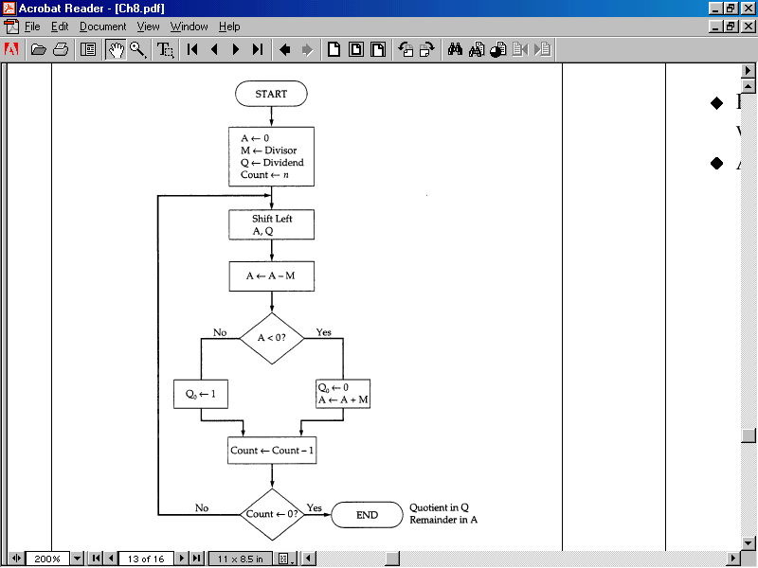
Flowchart for Unsigned Binary division

Slide 35
Real Numbers
Numbers with fractions
Could be done in pure binary
  1001.1010 = 2⁴ + 2⁰ +2⁻¹ + 2⁻³ =9.625
Where is the binary point?
Fixed?
  Very limited
Moving?
  How do you show where it is?

Slide 36
Floating Point
Sign bit
Biased
Exponent
Significand or Mantissa
+/- .significand x 2^{exponent}
Point is actually fixed between sign bit and body of mantissa
Exponent indicates place value (point position)

Slide 37
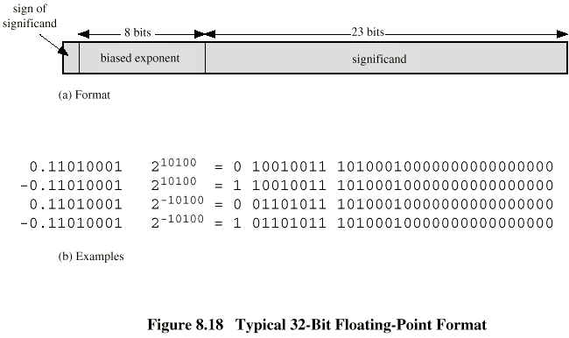
Floating Point Examples

Slide 38
Signs for Floating Point
Exponent is in excess or biased notation
  e.g. Excess (bias) 127 means
  8 bit exponent field
  Pure value range 0-255
  Subtract 127 to get correct value
  Range -127 to +128
The relative magnitudes (order) of the numbers do not change.
  Can be treated as integers for comparison.

Slide 39
Normalization //
FP numbers are usually normalized
i.e. exponent is adjusted so that leading bit (MSB) of mantissa is 1
Since it is always 1 there is no need to store it
(c.f. Scientific notation where numbers are normalized to give a single digit before the decimal point
e.g. 3.123 x 10³)

Slide 40
FP Ranges
For a 32 bit number
  8 bit exponent
  +/- 2²⁵⁶ ≈ 1.5 x 10⁷⁷
Accuracy
  The effect of changing lsb of mantissa
  23 bit mantissa 2⁻²³ ≈ 1.2 x 10⁻⁷
  About 6 decimal places

Slide 41
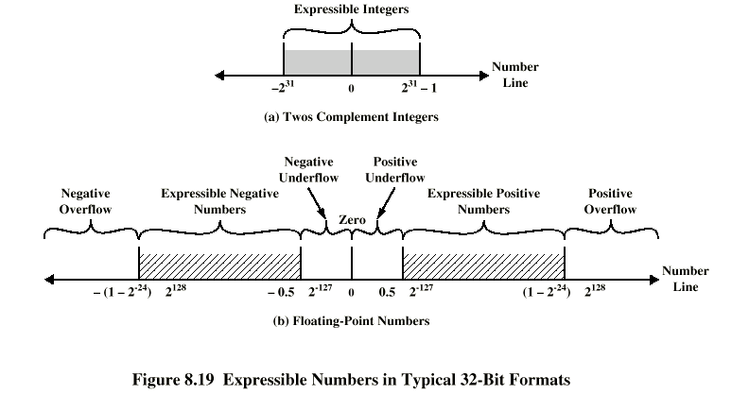
Expressible Numbers

Slide 42
IEEE 754
Standard for floating point storage
32 and 64 bit standards
8 and 11 bit exponent respectively
Extended formats (both mantissa and exponent) for intermediate results
Representation: sign, exponent, faction
  0: 0, 0, 0
  -0: 1, 0, 0
  Plus infinity: 0, all 1s, 0
  Minus infinity: 1, all 1s, 0
  NaN; 0 or 1, all 1s, =! 0

Slide 43
FP Arithmetic +/-
Check for zeros
Align significands (adjusting exponents)
Add or subtract significands
Normalize result

Slide 44
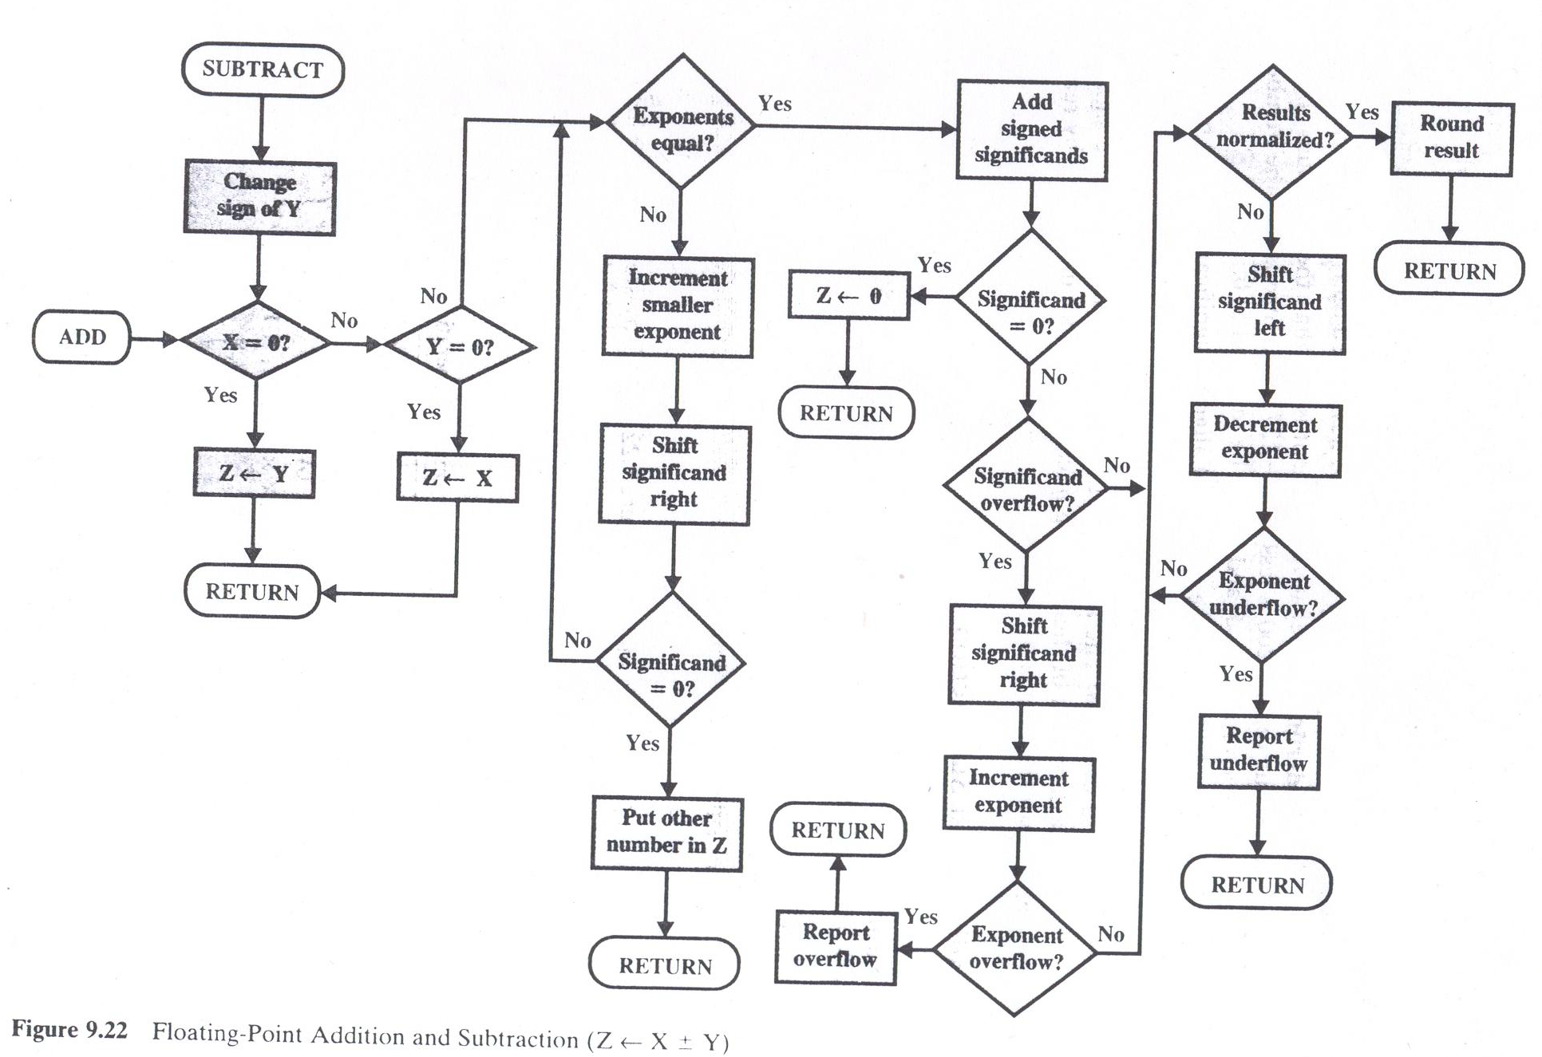
Floating point addition/subtraction

Slide 45
FP Arithmetic x/÷
Check for zero
Add/subtract exponents
Multiply/divide significands (watch sign)
Normalize
Round
All intermediate results should be in double length storage

Slide 46
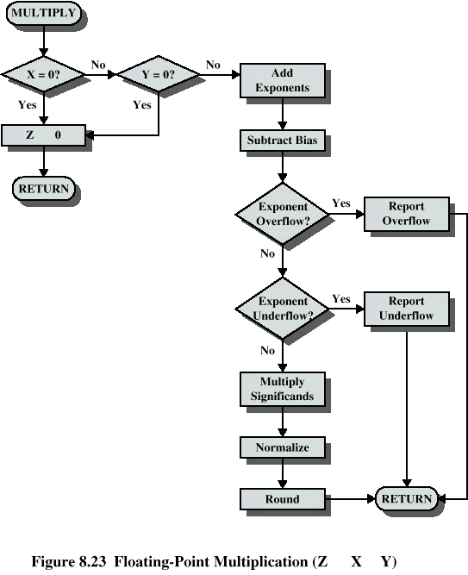
Floating
Point
Multiplication

Slide 47
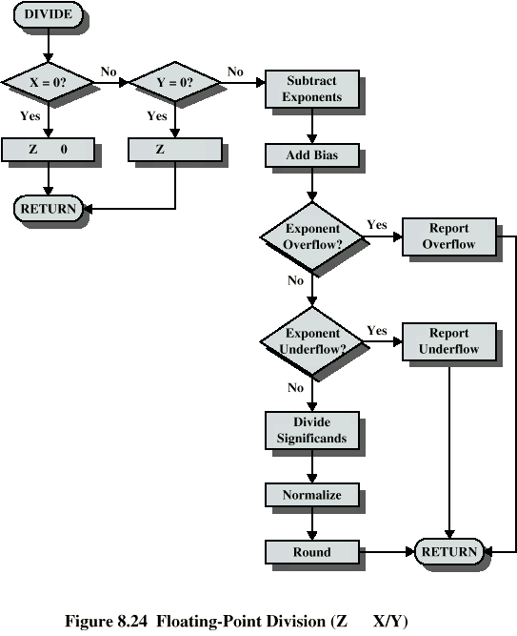
Floating
Point
Division

Slide 48
Round up
If the extra bits beyond 23 bits that can be stored (e.g 10010), are more than one half of the last representable bit position, round up causes addition of binary 1 to the last representable bit.
If the extra bits are 0111, amounts less than one half of the last representable bit position, then extra bits are dropped (truncated).

